Slide 1

Inside Sherpa – Digital Internship
Technology, Strategy & Transformation – Technology Optimisation & Delivery Module

Slide 2
Project Plan for SectorMetric
This project plan will outline how Deloitte will deliver this technology evaluation and selection engagement.
Our understanding
Risks, issues and dependencies
Providing an evaluating / scoring methodology for a new financial accounting system for the organisation
List of proposed technology solutions.
Guide and provide framework on requirement elicitation and requitement analysis
Lack of responsibility cannot be ignored. It can be mitigated by effective communication, building an ideal team and a high sense of responsibility and productivity
Lack of availability of Subject Matter Experts and relevant stakeholders may present a risk to delivery timelines.

Slide 3
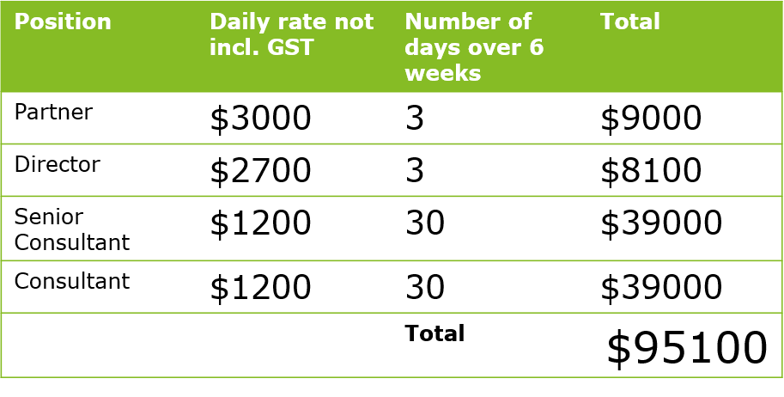
Project Plan for SectorMetric
This project plan will outline how Deloitte will deliver this technology evaluation and selection engagement.
Initial project timeline
Resource plan and estimation of fees
Guidance: Sample project timeline. Populate using the given information.
Guidance: Resource plan and estimation fees are usually broken down into components. This outlines a price tag to the client.
Phase
Activity 1
Activity 2
Activity 3
Weekly Leads Meeting
Milestone
Project status meeting

Slide 4
HIGH RISK CONFIDENTIAL
CONFIDENTIAL
PUBLIC

